Slide 1
UNIT - I
Overview of C: C Language Elements, Variable Declarations and Data Types, Executable Statements, General Form of a C Program, Arithmetic Expressions.
Selection Structures: Control Structures, Conditions, if Statement, if Statements with Compound Statements, Decision Steps in Algorithms.
Repetition and Loop Statements: Repetition in Programs, Counting Loops and the while Statement, Computing a Sum or Product in a Loop, for Statement, Conditional Loops, Loop Design, Nested Loops, do-while Statement.
Department of CSE

Slide 2
History of C
1967 – BCPL: BCPL (Basic Combined Programming Language) was developed by Martin Richards. It influenced the development of later programming languages.
1970 – B Language: Ken Thompson developed the B programming language at Bell Labs. B was influenced by BCPL.
1972 – C Language: Dennis Ritchie developed C at Bell Laboratories (Bell Labs). C was derived from the B language.
1972 – UNIX: C was developed to help create and develop the UNIX Operating System.
1989 – ANSI C: C was standardized by the American National Standards Institute (ANSI), known as C89 (ANSI C).
1990 – C90: C was standardized by ISO, resulting in the C90 standard.
1999 – C99: C99 introduced several new features and improvements.
2011 – C11: C11 added improvements related to performance, concurrency, and standard libraries.
2018 – C17: C17 provided corrections and improvements to the C standard.
2023 – C23: C23 introduced further modern features and improvements.
C became popular because of its speed, efficiency, portability, and flexibility
Today, C is widely used in operating systems, embedded systems, compilers, device drivers, databases, networking, and application software.
Department of CSE

Slide 3
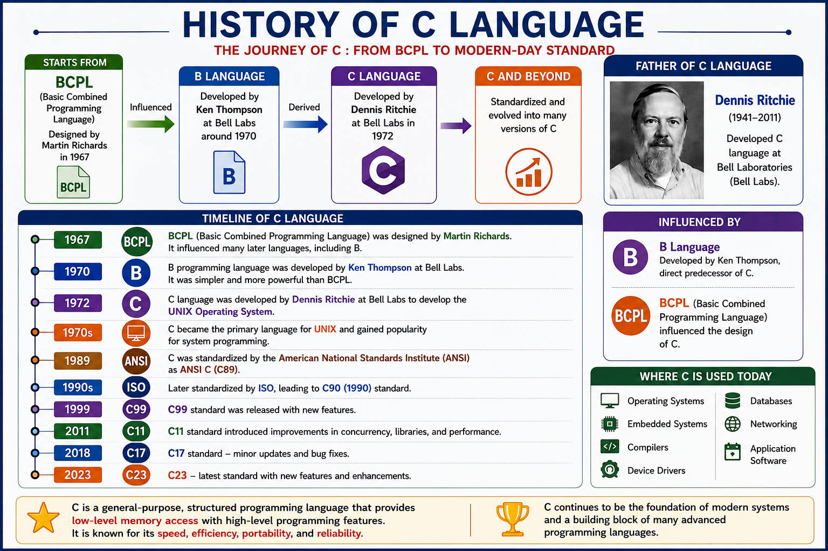
Department of CSE

Slide 4
Features of C
Simple – Easy to learn and use with a small set of keywords.
Structured – Supports modular programming using functions.
Portable – Programs can run on different platforms.
Fast and Efficient – Produces high-performance programs.
General-Purpose – Suitable for developing a wide range of applications.
Middle-Level Language – Combines features of both high-level and low-level languages.
Rich Library – Provides a large collection of built-in functions.
Pointers Support – Allows direct memory access and efficient memory management.
Dynamic Memory Allocation – Memory can be allocated and deallocated during program execution.
Recursion – Functions can call themselves to solve problems recursively.
Extensible – Users can create their own functions and libraries.
Case-Sensitive – Treats uppercase and lowercase letters as different.
Compiler-Based – Source code is compiled into machine code for faster execution.
Widely Used – Used in operating systems, embedded systems, device drivers, compilers, databases, networking, and application software.
Department of CSE

Slide 5
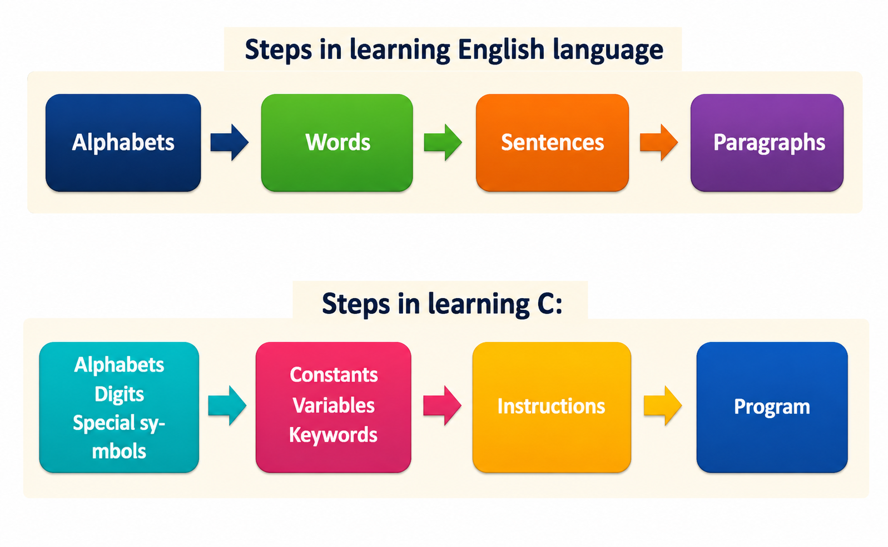
Learning English Language vs C Language
Department of CSE

Slide 6
C Language Elements
C language elements are the basic building blocks of a C program.
    Character Set
    Tokens
    Keywords
    Identifiers
    Variables
    Constants
    Data Types
    Operators
    Expressions
    Statements
Department of CSE

Slide 7
C Language Elements
1.Character Set
      Letters (A–Z, a–z) ,Digits (0–9) ,Special Symbols (+, -, *, {}, (), etc.) ,White Spaces (space, tab, newline)
2. Tokens
The smallest individual units of a C program.
      Keywords, Identifiers ,Constants ,Variables ,Operators ,Special Symbols, Strings
3. Keywords
      Reserved words with predefined meanings.
      Examples: int, float, if, else, while, return
4. Identifiers
      Names given to variables, functions, arrays, etc.
      Example: sum, marks, main
Department of CSE

Slide 8
C Language Elements
5. Variables
  Named memory locations used to store data.
  Example: int age = 20;
6. Constants
  Fixed values that do not change during program execution.
  Example: 10, 3.14, 'A', "Hello"
7. Data Types
  Specify the type of data stored.
  Examples: int,float ,char,double,void
8. Operators
  Perform operations on data.
  Types: Arithmetic ,Relational ,Logical ,Assignment ,Bitwise ,Increment/Decrement
9. Expressions
  Combination of variables, constants, and operators.
      Example: sum = a + b;
10. Statements
  Instructions executed by the program.
      Example: printf("Hello");
Department of CSE

Slide 9
Variables in ‘C’
A variable is a named memory location used to store data. Its value can change during program execution.
Like human memory the computer memory also consists of millions of cells. The calculated values are stored in these memory cells.
Variable Declaration: A variable declaration tells the compiler the name and data type of a variable before it is used.
  Example:
    int age;
    float salary;
    char grade;
Variable Initialization: Variable initialization is the process of assigning an initial value to a variable at the time of declaration.
  Assigning a value to a variable at the time of declaration.
    int age = 20;
    float salary = 35000.50;
    char grade = 'A’;
Department of CSE

Slide 10
The four main types of variables in C are:
  Local Variable
  Global Variable
  Static Variable
  Register Variable
  1.Local Variable
    A variable declared inside a function or block.
  Example
        #include <stdio.h>
        int main()
        {
        int x = 10; // Local variable
        printf("%d", x);
        return 0;
        }
Accessible only inside the block where it is declared.
Department of CSE

Slide 11
2.Global Variables
    A variable declared outside all functions.
  Example
        #include <stdio.h>
        int x = 10; // Global variable
        int main() {
        printf("%d", x);
        return 0;
        }
Can generally be accessed by multiple functions in the same source file.
Department of CSE

Slide 12
3.Static Variables
  A static variable preserves its value between function calls.
  Example
        #include <stdio.h>
        void display()
        {
        static int count = 0;
        count++;
        printf("%d\n", count);
        }
        int main()
        {
        display();
        display();
        display();
        return 0;
        }
It is initialized only once and retains its value.
Department of CSE

Slide 13
4.Register Variables
  A register variable is a variable declared using the register keyword.
  It requests the compiler to store the variable in a CPU register for faster access.
  Example
        #include <stdio.h>
        int main()
        {
        register int i;
        for (i = 0; i < 5; i++)
        printf("%d ", i);
        return 0;
        }
Department of CSE

Slide 14
Rules for Variables in C
A variable name should begin with a letter or an underscore (_).
It should not start with a number.
It can contain letters, numbers, and underscores.
Spaces and special characters are not allowed.
C keywords (such as int, float, and if) cannot be used as variable names.
Variable names are case-sensitive, so age and Age are treated as different variables.
A variable must be declared before it is used in the program.
Department of CSE

Slide 15
Data Types in ‘C’
A data type in C specifies:
    What kind of data a variable can store.
    How much memory is allocated for the variable.
    What operations can be performed on the data.
The data types in C can be classified as follows:
  Primitive Data Types – Basic types like int, float, char, etc.
  Derived Data Types – Formed from primitive types, e.g. arrays, pointers, structures, functions.
  User-Defined Data Types – Created by the user, e.g. struct, union, enum, typedef.
Department of CSE

Slide 16
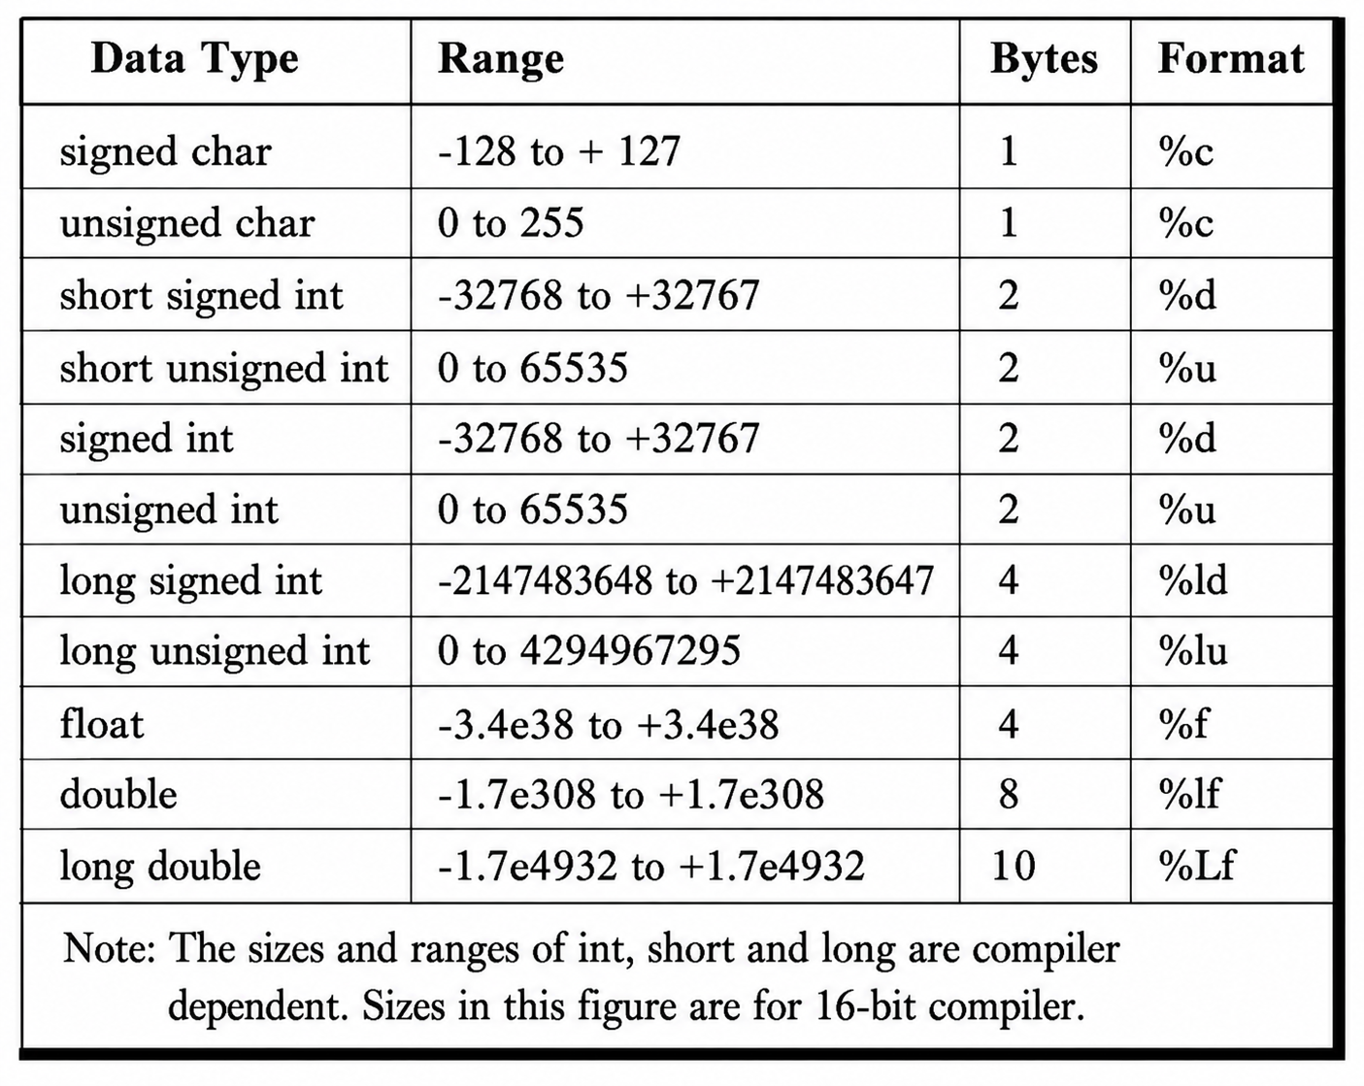

Slide 17
General Form of a ‘C’ Program
A C program is generally divided into different sections.
Each section has a specific purpose in developing and executing the program.
        Documentation Section
        Link / Preprocessor Section
        Definition Section
        Global Declaration Section
        main() Function
        User-Defined Functions
Department of CSE

Slide 18
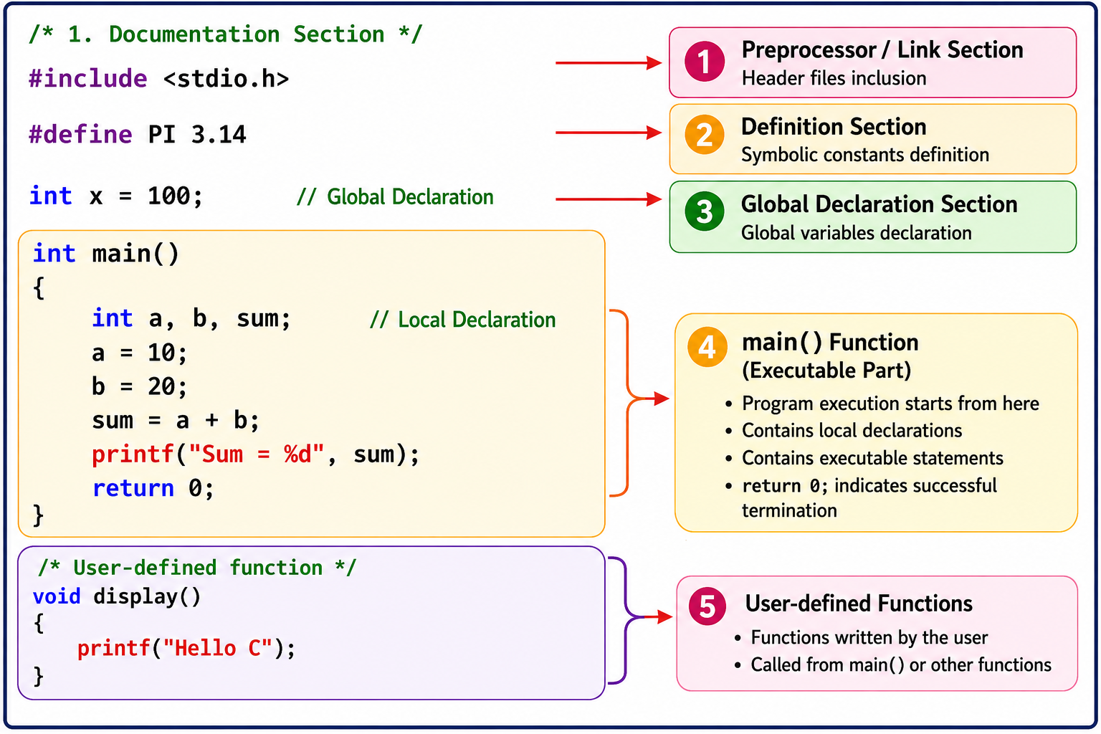
General Form of a ‘C’ Program
Department of CSE

Slide 19
General Form of a ‘C’ Program
1.Documentation Section
Contains comments that explain the purpose of the program.
Example:
/* Program to add two numbers */
2. Link / Preprocessor Section
Includes header files required for predefined functions.
Example:
#include <stdio.h>
3. Definition Section
Defines constants using #define.
Example:
#define PI 3.14
4. Global Declaration Section
Contains variables declared outside all functions.
Example:
int count = 10;
Department of CSE

Slide 20
General Form of a ‘C’ Program
5. main() Function
The starting point of program execution. It contains declarations and executable statements.
Example:
  int main()
  {
  int a = 10, b = 20;
  printf("%d", a + b);
  return 0;
  }
6. User-Defined Functions
Functions created by the programmer to perform specific tasks.
Example:
  void display()
  {
  printf("Hello C");
  }
Department of CSE

Slide 21
Key words
Keywords are reserved words in C that have a predefined meaning to the compiler.
They cannot be used as variable, function, or identifier names.
The keywords are also called ‘Reserved words’ or ‘Pre-defined words’.
There are 32 Keywords in C.
The keywords cannot be used as variable names.
Department of CSE

Slide 22
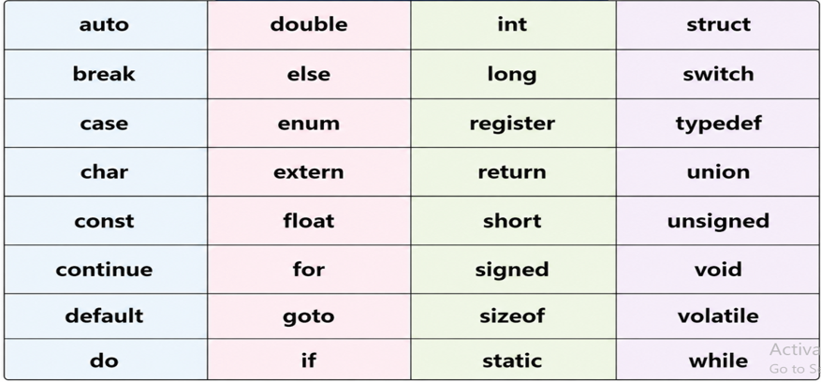
Key words
Department of CSE

Slide 23
Control statements in ‘C’
Control statements in C are used to alter the flow of execution of statements in a program.
They decide whether a block of code should be executed, repeated, or skipped.
In C, control statements are mainly classified into three types:
1. Decision-Making Statements or Selection statements or Branching statements
2. Looping Statements or Iterative Statements or repetitive statements
3. Transfer Statements or Jump Statements
Department of CSE

Slide 24
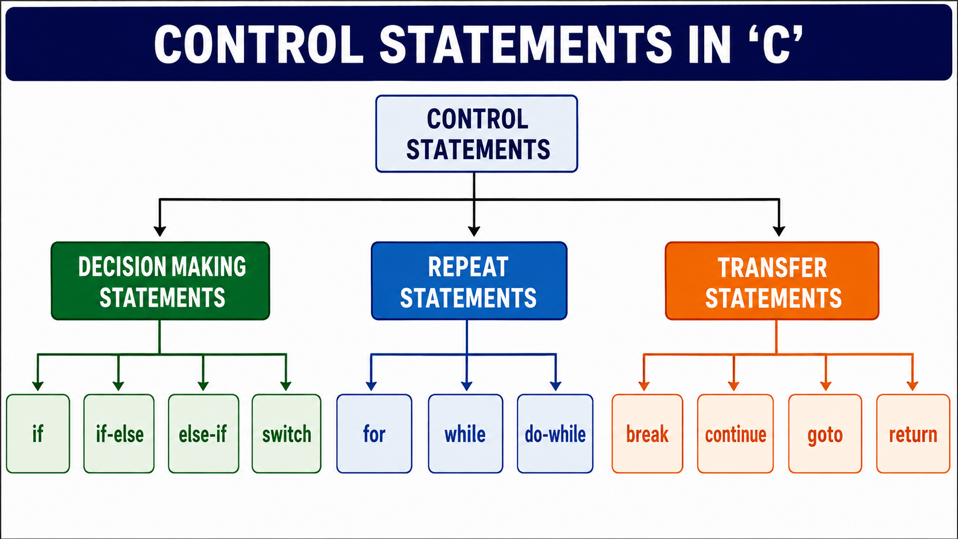
Control Statements in ‘C’
Department of CSE

Slide 25
Conditional Statements
• Conditional/Decision-Making Statements are statements used to evaluate a condition and control the execution of a block of code based on whether the condition is True or False.
In the c programming language, there are two decision-making statements they are as follows.
    if statement
    switch statement
Department of CSE

Slide 26
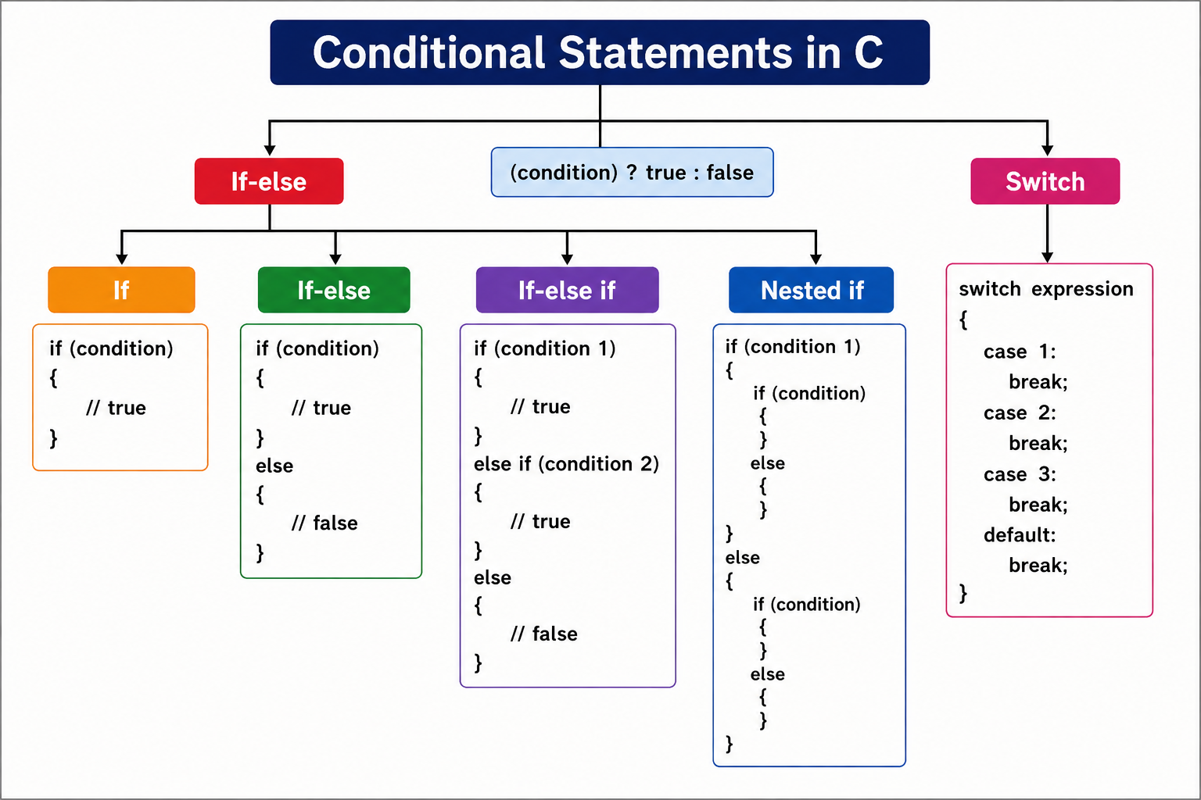
Department of CSE

Slide 27
if statement in C
The if statement is used to make a decision based on a condition.
It executes a block of statements only when the condition is true.
In c, if statement is classified into four types as follows...
    Simple if statement
    if-else statement
    Nested if statement
    if-else-if statement (if-else ladder)
Department of CSE

Slide 28
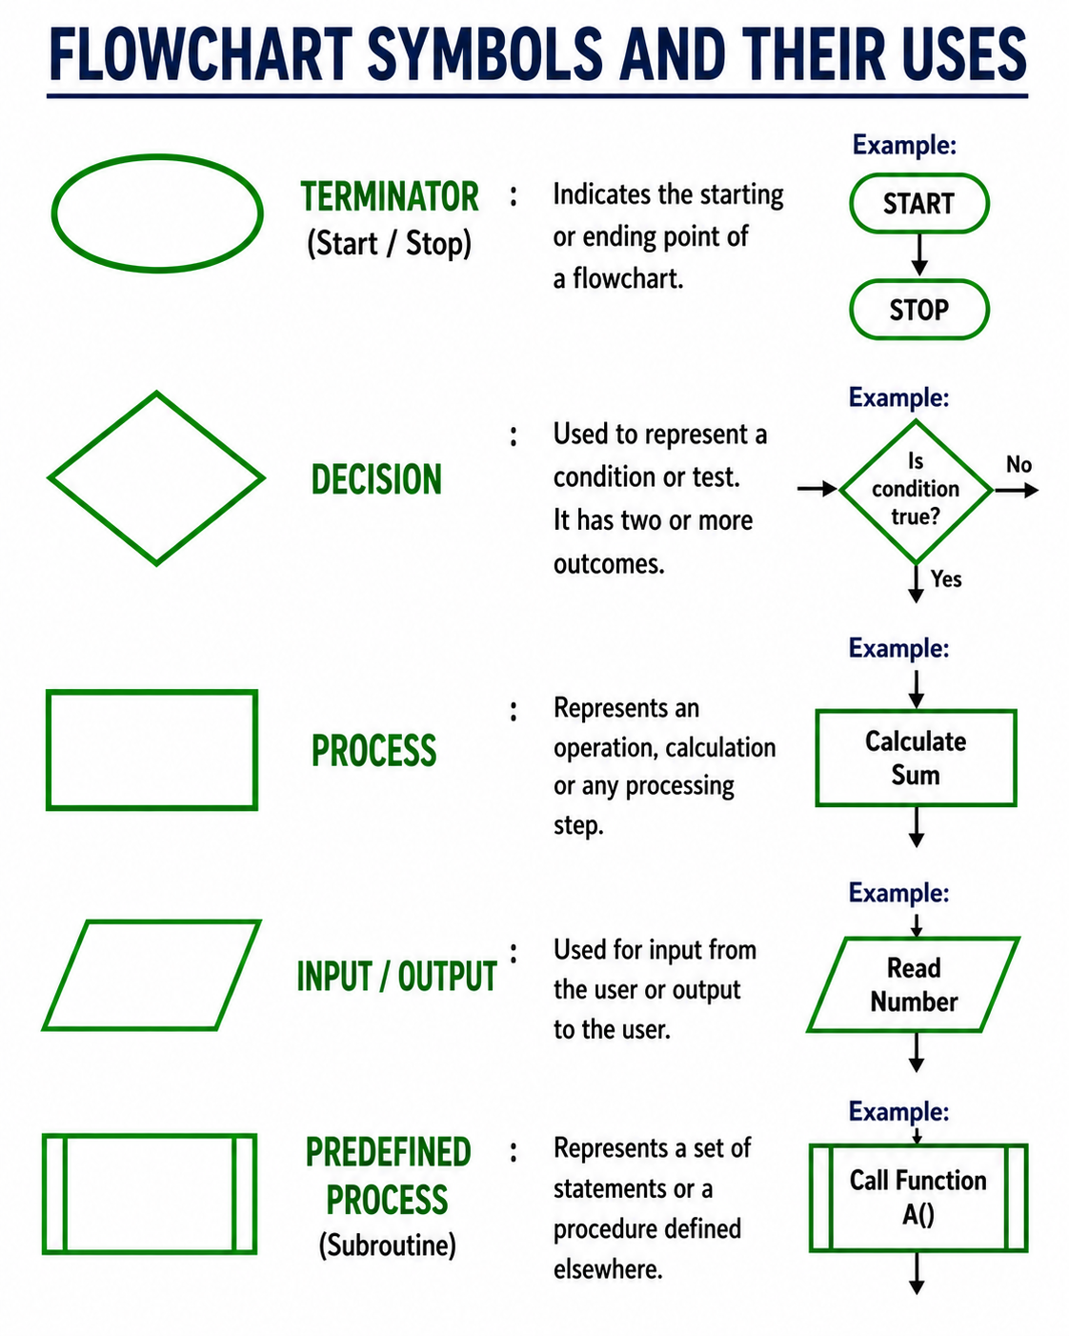
Department of CSE

Slide 29
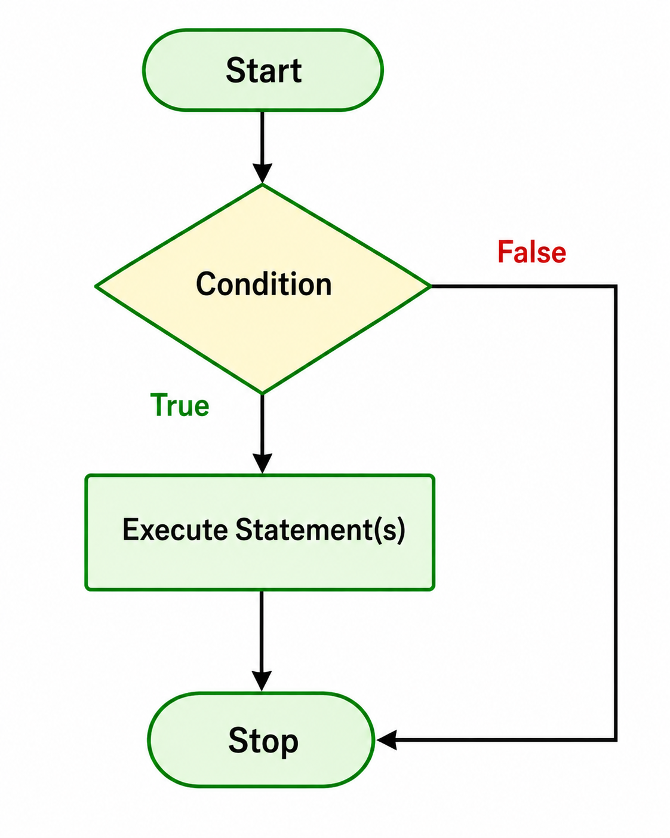
Simple if statement
Syntax:
if(condition)
{
// Statements to execute if
// condition is true
}
Department of CSE

Slide 30
Simple if statement- Example
// C program to illustrate If statement
#include <stdio.h>
int main()
{
int i = 10;
if (i > 15)
{
printf("10 is less than 15");
}
printf("I am Not in if");
}
Department of CSE

Slide 31
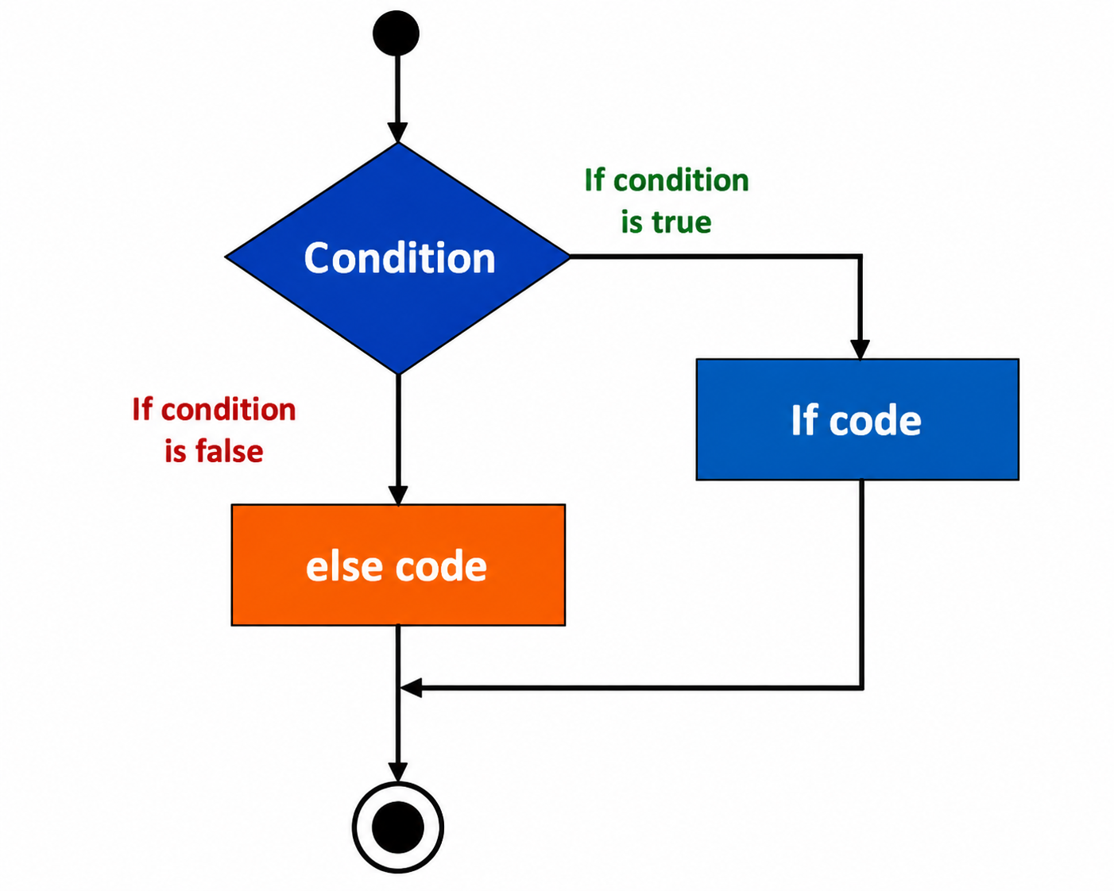
If-else statement
Syntax:
if (condition)
{
// Executes this block if
// condition is true
}
else
{
// Executes this block if
// condition is false
}
Department of CSE

Slide 32
If-else statement-Example
// C program to illustrate If statement
#include <stdio.h>
int main()
{
int i = 20;
if (i < 15)
printf("i is smaller than 15");
else
printf("i is greater than 15");
return 0;
}
Department of CSE

Slide 33
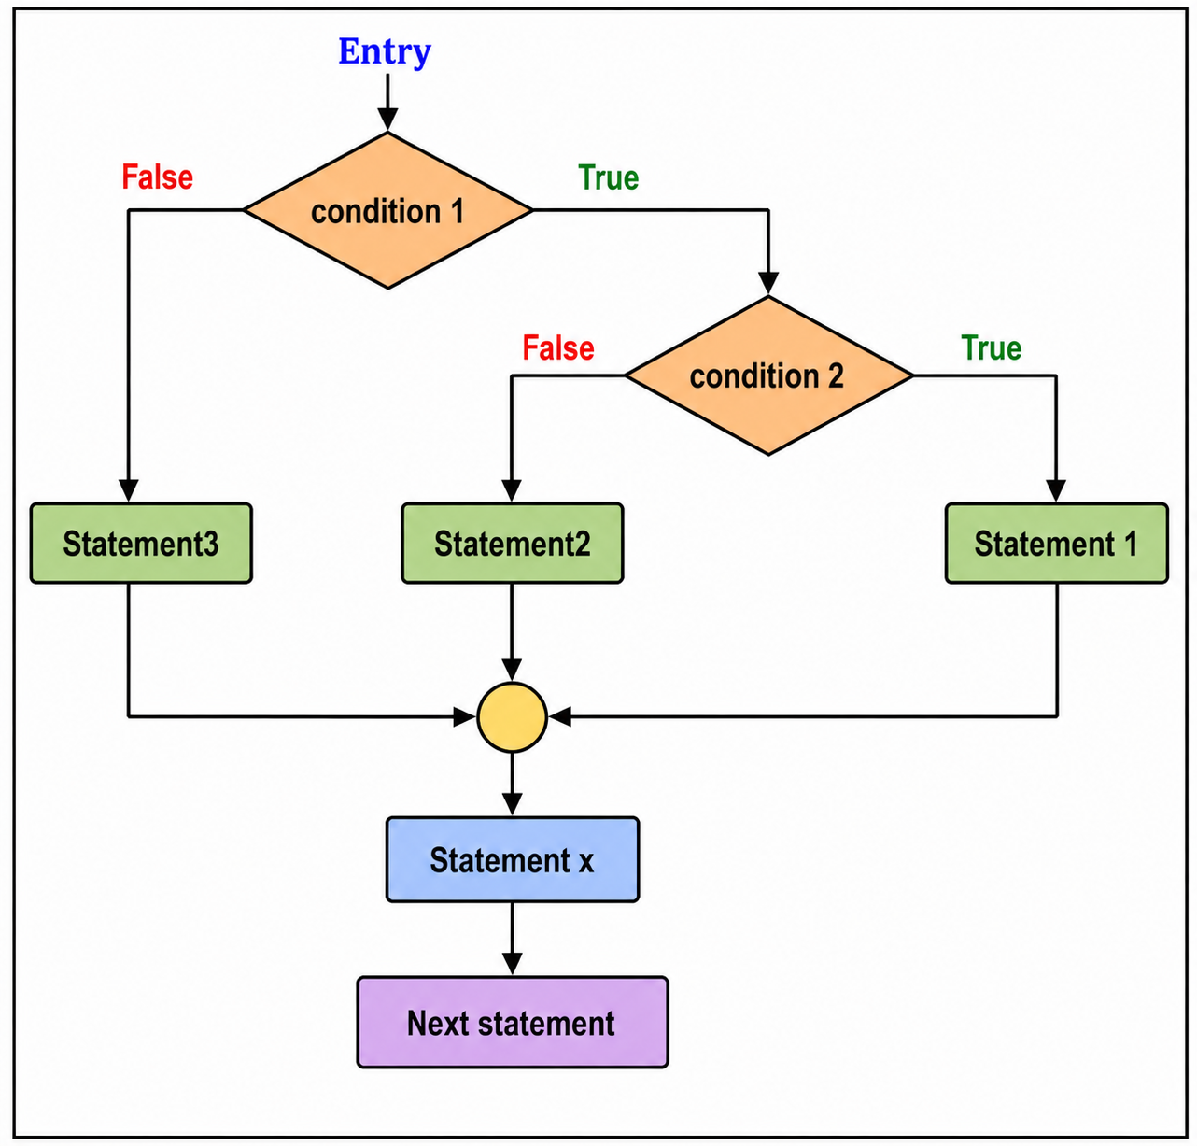
Nested if-else statement
Syntax:
if( condition 1 )
{
if(condition 2 )
{
statement 1;
}
else
{
statement 2;
}
}
else
{
statement 3;
}
Department of CSE

Slide 34
Nested if-else statement-Example
#include <stdio.h>
void main( )
{
int a, b, c;
printf("Enter 3 numbers...");
scanf("%d%d%d",&a, &b, &c);
if(a > b)
{
if(a > c)
{
printf("a is the greatest");
}
else
{
printf("c is the greatest");
}
}
else
{
if(b > c)
{
printf("b is the greatest");
}
else
{
printf("c is the greatest");
}
}
}
Department of CSE

Slide 35
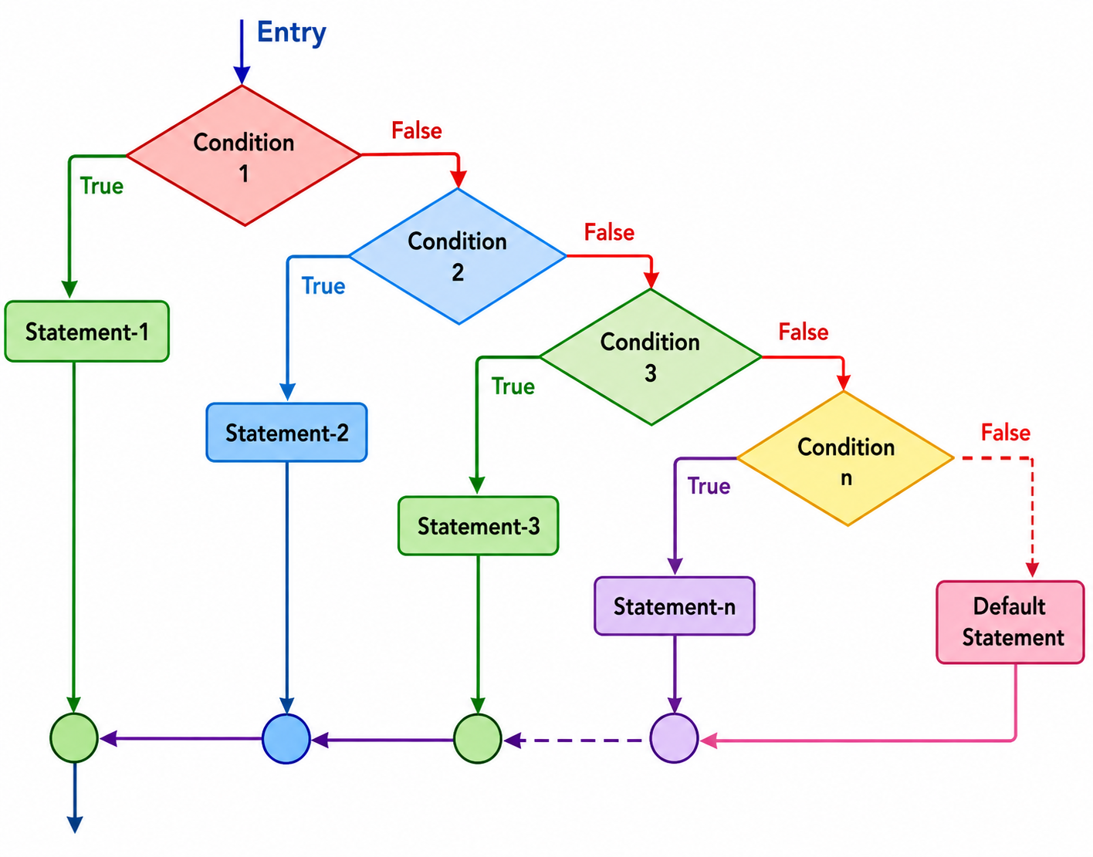
if-else-if ladder statement
Syntax:
if(Condition 1)
{
statement block1;
}
else if(Condition 2)
{
statement block2;
}
else if(Condition 3 )
{
statement block3;
}
….
else
default statement;
Department of CSE

Slide 36
if-else-if ladder statement-Example
#include <stdio.h>
void main( )
{
int a;
printf("Enter a number...");
scanf("%d", &a);
if(a%5 == 0 && a%8 == 0)
{
printf("Divisible by both 5 and 8");
}
else if(a%8 == 0)
{
printf("Divisible by 8");
}
else if(a%5 == 0)
{
printf("Divisible by 5");
}
else
{
printf("Divisible by none");
}
}
Department of CSE

Slide 37
Switch Statement
Switch statement is a control statement that allows us to choose only one choice among the many given choices.
The expression in switch evaluates is compared to the values present in different cases.
It executes that block of code which matches the case value.
If there is no match, then default block is executed(if present).
Department of CSE

Slide 38
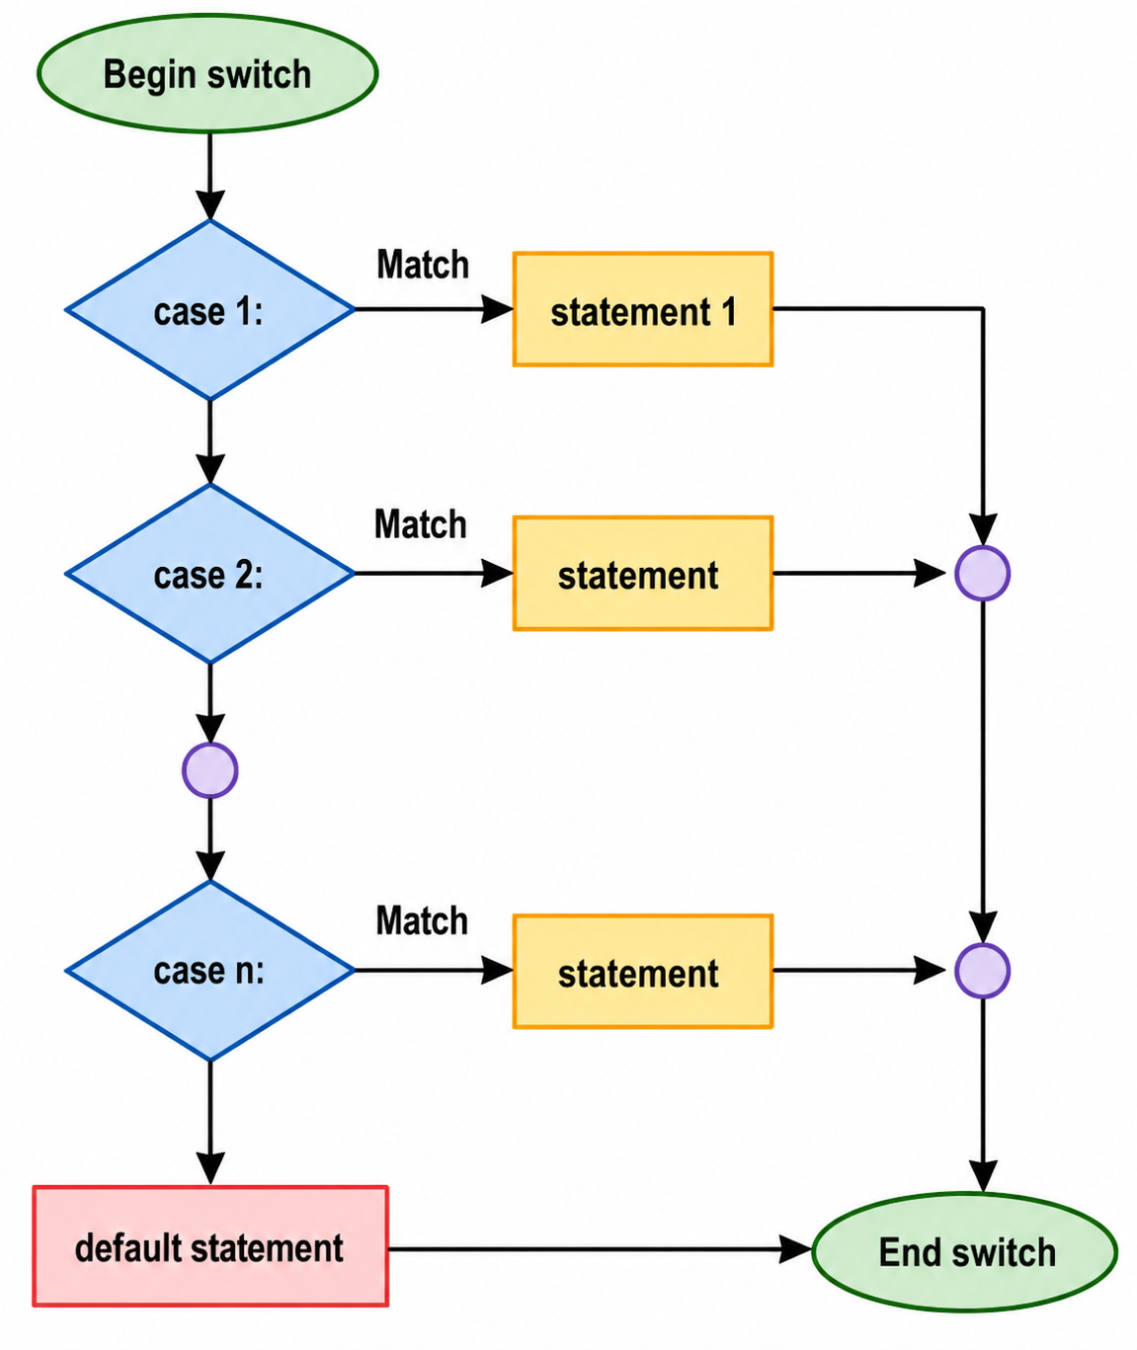
Switch Statement
switch(expression)
{
case value-1:
block-1;
break;
case value-2:
block-2;
break;
case value-3:
block-3;
break;
case value-4:
block-4;
break;
default:
default-block;
break;
}
Department of CSE

Slide 39
Switch Statement Rules
1) The switch expression must be of an integer or character type.
2) The case value must be an integer or character constant.
3) The case value can be used only inside the switch statement.
4) The break statement in switch case is not must. It is optional. If there is no break statement found in the case, all the cases will be executed present after the matched case.
Department of CSE

Slide 40
Switch Statement Example
#include <stdio.h>
int main()
{
char operator;
int n1, n2;
printf("Enter an operator (+, -, *, /): ");
scanf("%c", &operator);
printf("Enter two operands: ");
scanf("%d %d",&n1, &n2);
switch(operator)
{
case '+':
printf("%d + %d = %d",n1, n2, n1+n2);
break;
case '-':
printf("%d - %d = %d",n1, n2, n1-n2);
break;
case '*':
printf("%d * %d = %d",n1, n2, n1*n2);
break;
case '/':
printf("%d / %d = %d",n1, n2, n1/n2);
break;
default:
printf("Error! operator is not correct");
}
return 0;
}
Department of CSE

Slide 41
Iterative Statements/ Loops
A loop is used to repeat a block of code until the specified condition is met. Using loops we do not need to write the same code again and again.
C programming has three types of loops:
while loop
do...while loop
for loop
These loops controlled either at entry level or at exit level hence loops can be controlled two ways:
Entry Controlled Loop
Exit Controlled Loop
Department of CSE

Slide 42
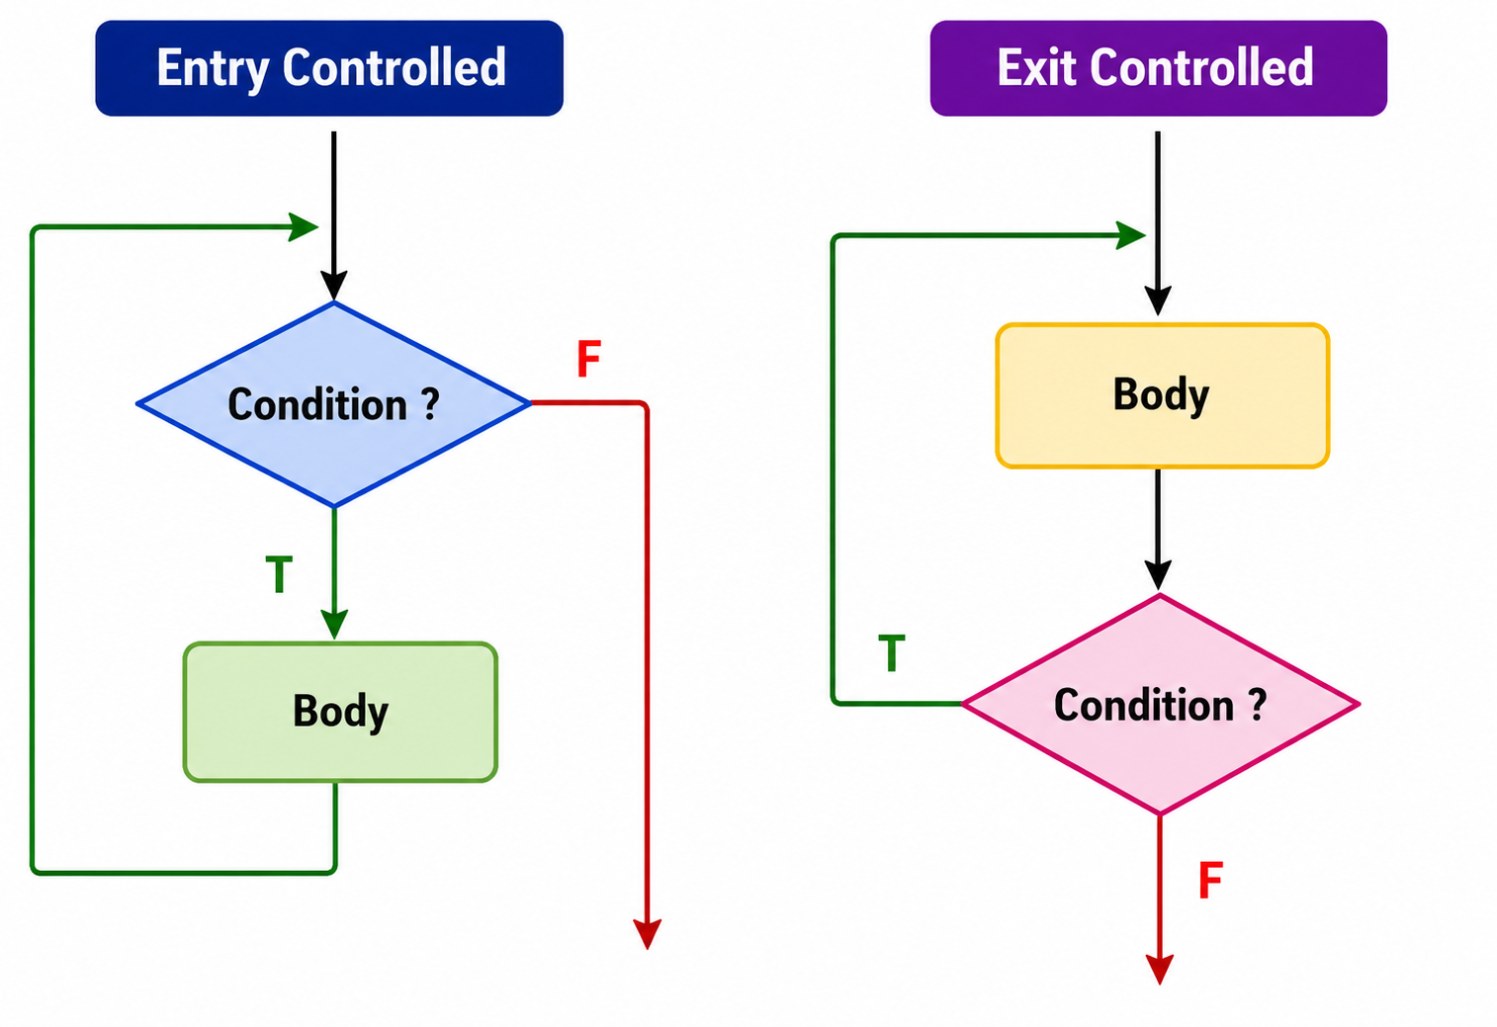
Iterative Statements/ Loops
Entry Controlled Loop
A loop in which the condition is checked before executing the loop body is called an entry Controlled Loop.
Examples: while loop, for loop
Exit Controlled Loop
A loop in which the condition is checked after executing the loop body is called an exit Controlled Loop.
Example: do-while loop
Department of CSE

Slide 43
While Loop
The while loop is an Entry-Controlled Loop or Pre-Test Loop.
It checks the condition before executing the loop body.
If the condition is true, the statements inside the loop are executed.
After execution, the condition is checked again.
This process continues until the condition becomes false.
If the condition is false initially, the loop body is not executed.
Department of CSE

Slide 44
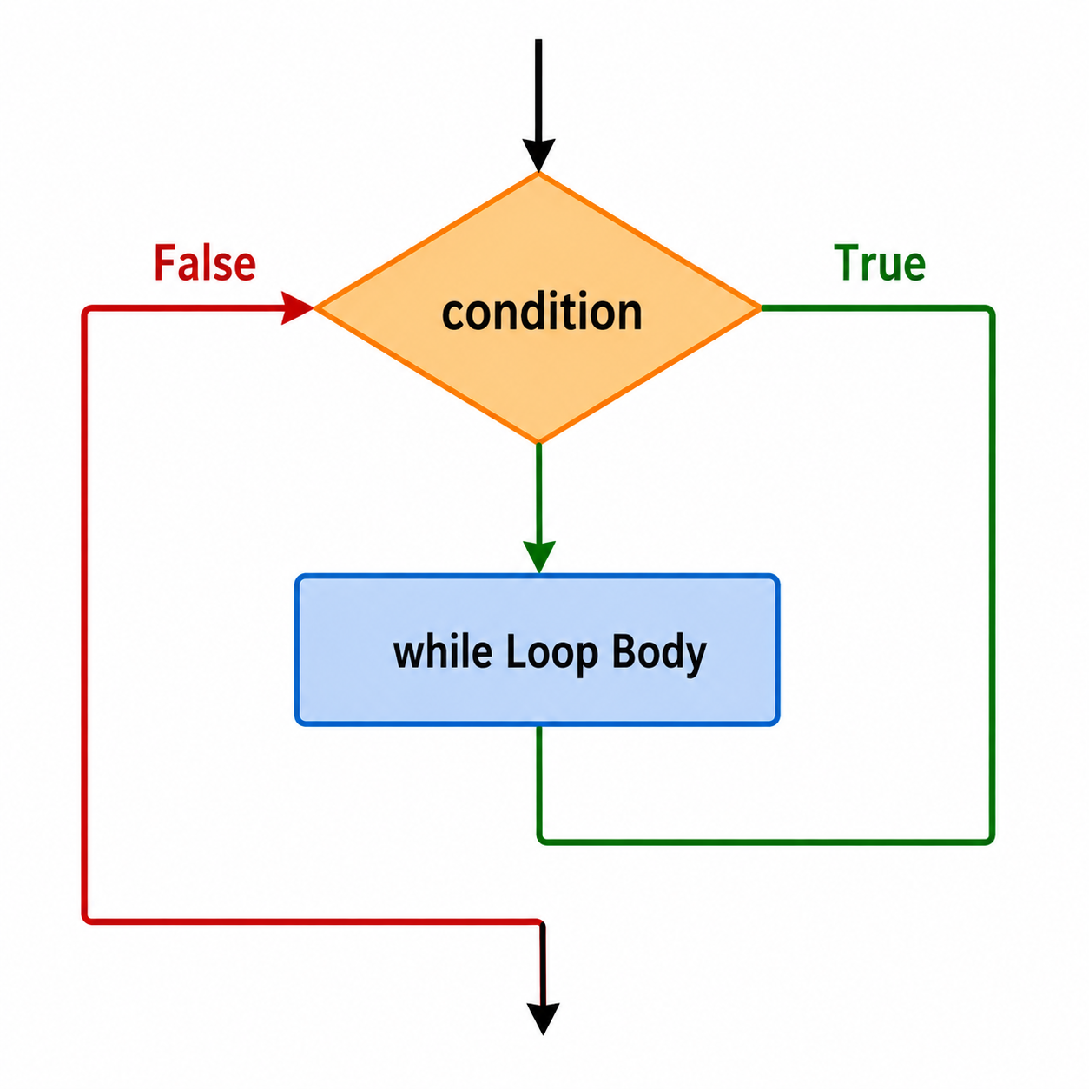
While Loop
Syntax:
while (condition)
{
// body of the loop
}
Department of CSE

Slide 45
While Loop-Example
// Print numbers from 1 to 5
#include <stdio.h>
int main()
{
int i = 1;
while (i <= 5)
{
printf("%d\n", i);
++i;
}
return 0;
}
Department of CSE

Slide 46
do-while Loop
The do-while loop is an Exit-Controlled Loop or Post-Test Loop.
The loop body is executed at least once before the condition is checked.
After executing the loop body, the condition is evaluated.
If the condition is true, the loop body executes again.
This process continues until the condition becomes false.
When the condition is false, the loop terminates.
Department of CSE

Slide 47
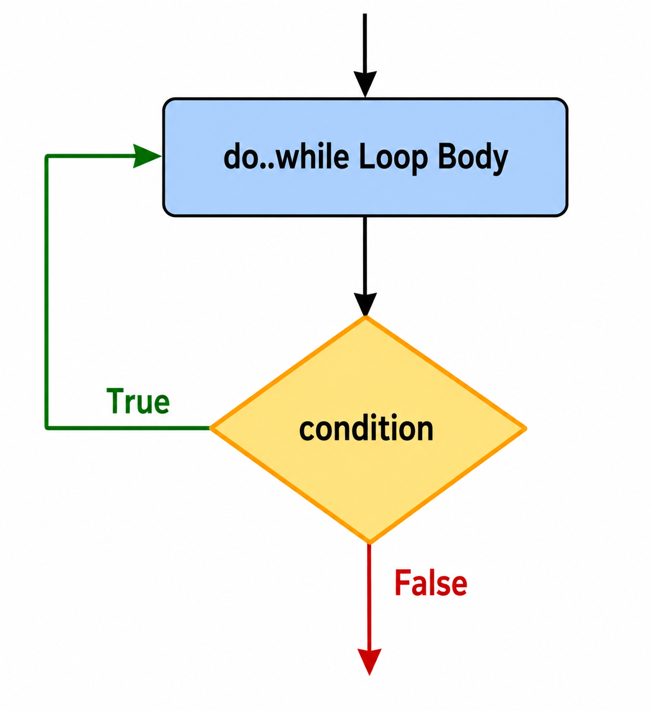
do-while Loop
Syntax:
do
{
//body of the loop
}
while (testExpression);
Department of CSE

Slide 48
do-while Loop-Example
#include<stdio.h>
void main()
{
int i;
i = 1;
do
{
printf("%d\t", i);
i++;
} while(i <= 5);
}
Department of CSE

Slide 49
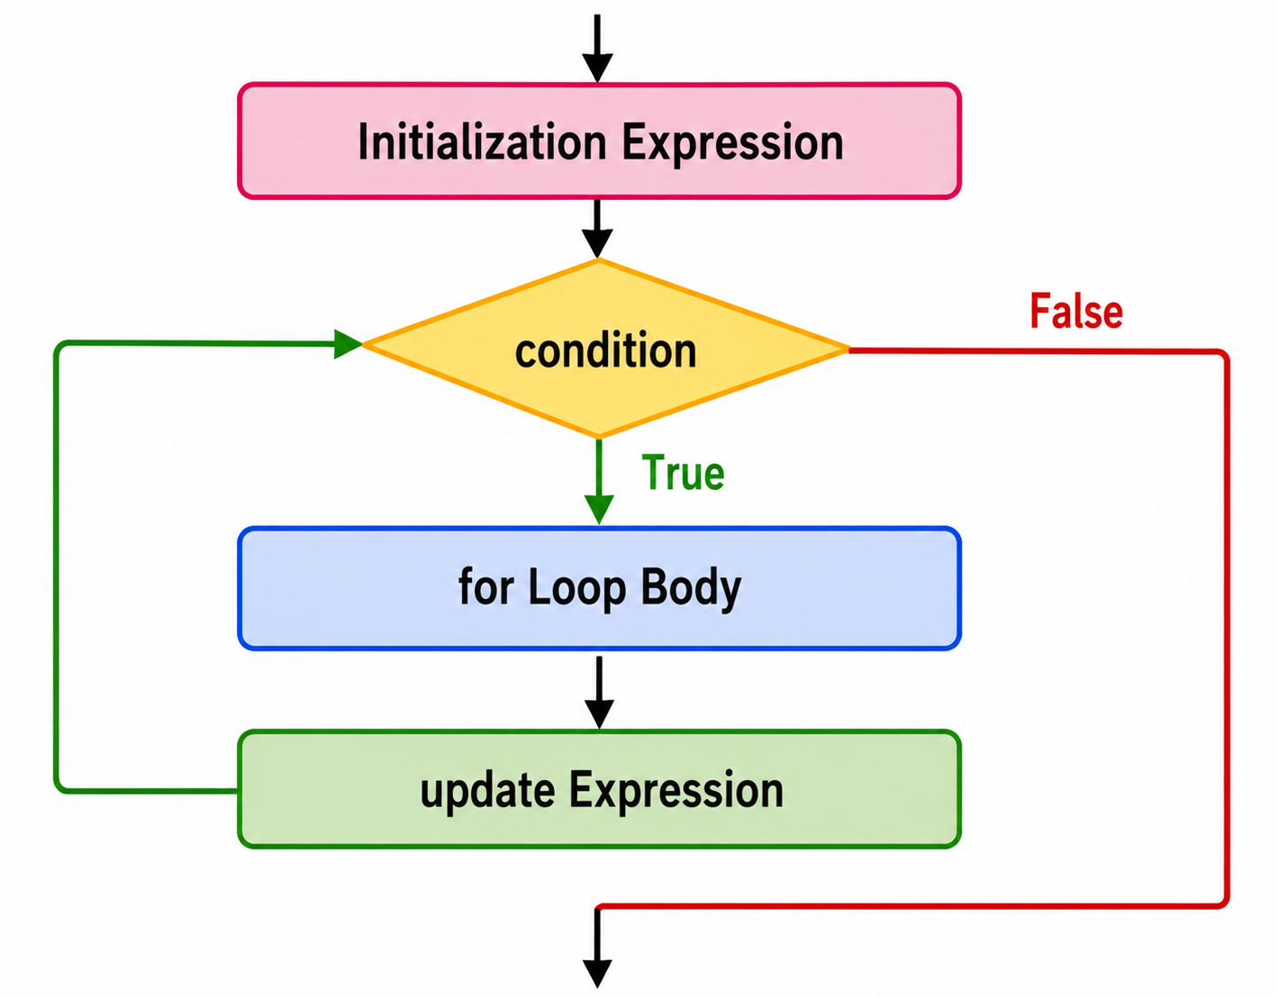
for Loop
Syntax:
for (initializationStatement; testExpression; updateStatement)
{
// body of loop
}
Department of CSE

Slide 50
for loop
The initialization statement is executed only once.
Then, the condition is checked.
If the condition is false, the for loop terminates.
If the condition is true, the statements inside the loop body are executed.
Then, the update expression is executed.
The condition is checked again.
This process continues until the condition becomes false.
When the condition is false, the loop terminates.
Department of CSE

Slide 51
for Loop-Example
#include <stdio.h>
int main() {
int i;
for (i = 1; i < =5; ++i)
{
printf("%d ", i);
}
return 0;
}
Department of CSE

Slide 52
break statement
The break statement ends the loop immediately when it is encountered.
Syntax:
break;
The break statement is almost always used with if...else statement inside the loop.
Department of CSE

Slide 53
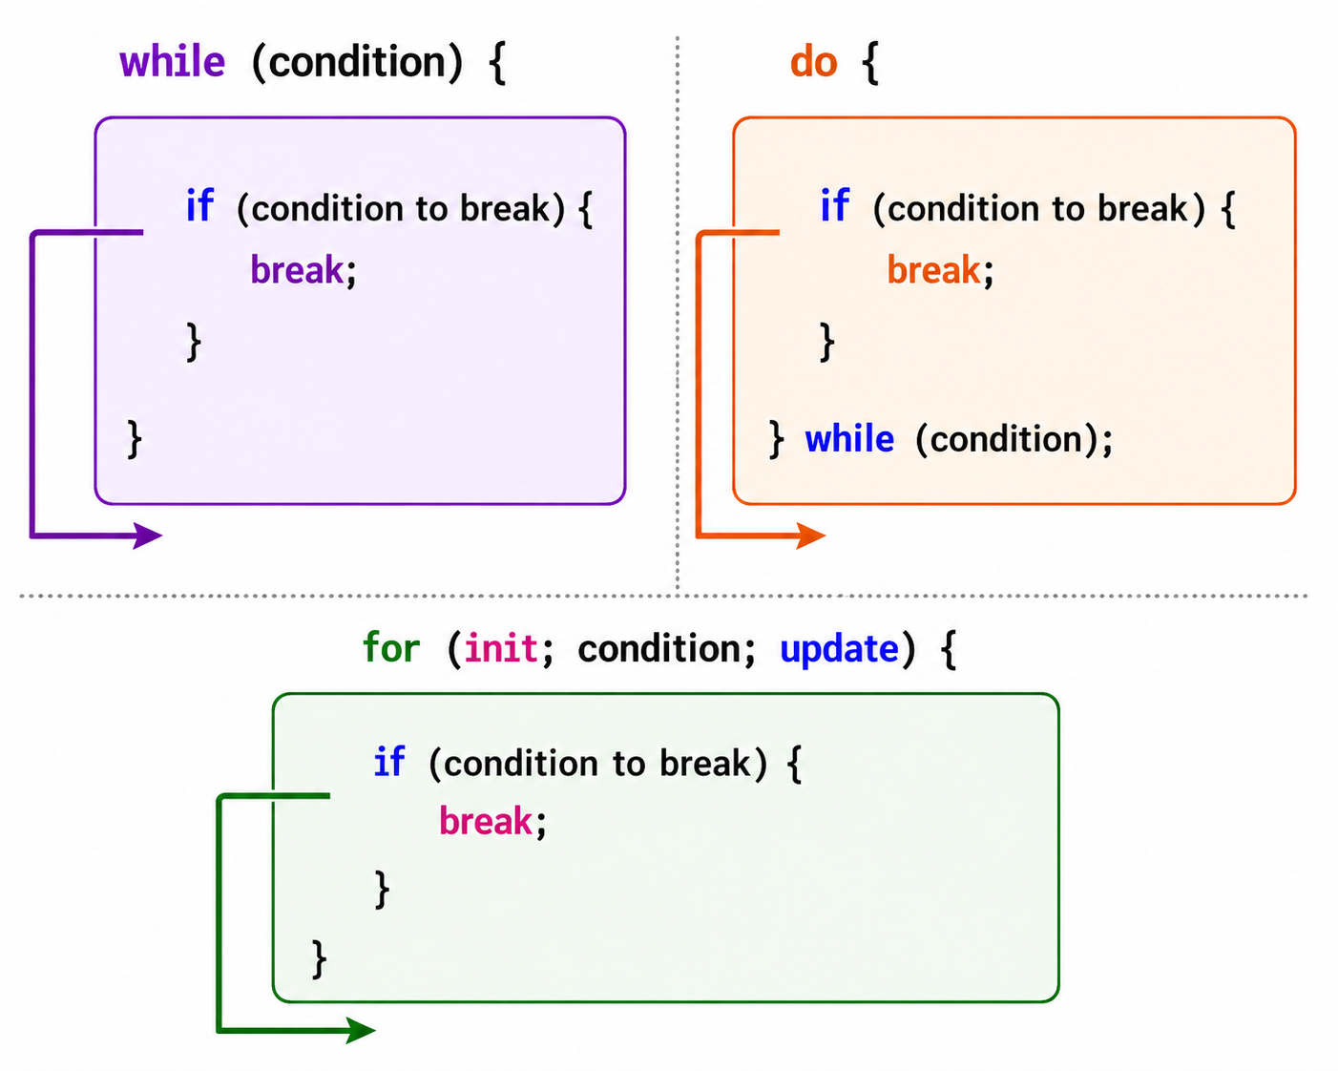
break statement
Department of CSE

Slide 54
break statement- Example
#include<stdio.h>
int main ()
{
int i;
for(i = 0; i<10; i++)
{
if(i == 5)
break;
printf("%d ",i);
}
printf("came outside of loop i = %d",i);
return 0;
}
Department of CSE

Slide 55
continue statement
The continue statement skips the current iteration of the loop and continues with the next iteration.
Syntax:
continue;
The continue statement is almost always used with the if...else statement.
Department of CSE

Slide 56
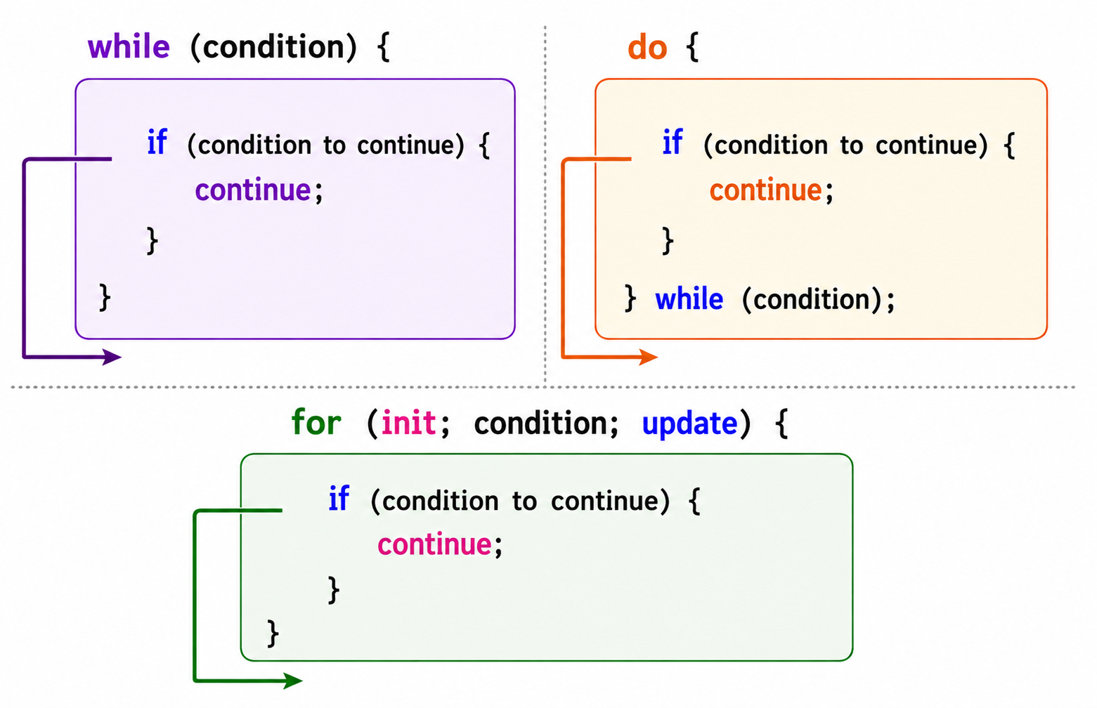
continue statement
Department of CSE

Slide 57
continue statement- Example
include<stdio.h>
int main ()
{
int i;
for(i = 0; i<10; i++)
{
if(i == 5)
continue;
printf("%d ",i);
}
printf("came outside of loop i = %d",i);
return 0;
}
Department of CSE

Slide 58
goto statement example
#include <stdio.h>
int main()
{
int n;
printf("Enter a number: ");
scanf("%d", &n);
if (n < 0)
goto negative;
printf("Positive number");
return 0;
negative:
printf("Negative number");
return 0;
}
Department of CSE

Slide 59
Computing a Sum in a Loop
Purpose:
A loop can be used to repeatedly add values and calculate their total sum.
#include <stdio.h>
int main()
{
int i, sum = 0;
for (i = 1; i <= 10; i++)
{
sum = sum + i;
}
printf("Sum = %d", sum);
return 0;
}
Department of CSE

Slide 60
Computing a Product in a Loop
Purpose:
A loop can be used to repeatedly multiply values and calculate their total product.
#include <stdio.h>
int main()
{
int i, product = 1;
for (i = 1; i <= 10; i++)
{
product = product * i;
}
printf("Product = %d", product);
return 0;
}
Department of CSE

Slide 61
Nested Loops in C
A nested loop is a loop placed inside another loop.
The inner loop executes completely for each iteration of the outer loop.
Syntax
for (initialization; condition; update)
{
for (initialization; condition; update)
{
// statements
}
}
Department of CSE

Slide 62
Nested Loops in C
Example: Nested for Loop
#include <stdio.h>
int main()
{
int i, j;
for (i = 1; i <= 3; i++)
{
for (j = 1; j <= 3; j++)
{
printf("%d %d\n", i, j);
}
}
return 0;
}
Department of CSE

